Slide 1
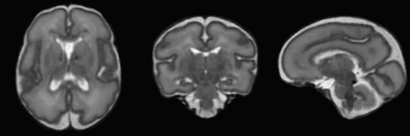


Improving Conditional Deformable Template Construction with Generative Adversarial Registration
www.neeldey.com/deformable-templates

Slide 2








Neel Dey¹
Mengwei Ren¹
Adrian V. Dalca^{2,3}
Guido Gerig¹
^{1.}
^{2.}
^{3.}

Slide 3
Outline
Deformable Registration: Old and New
Deformable Templates
Improved Deformable Templates
Neuroimaging Applications

Slide 4

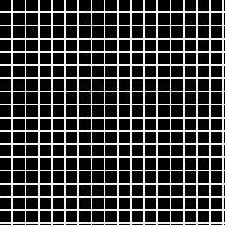

Deformable Registration
Image: Sarang Joshi
Original: Christensen, Rabbitt, Miller, TIP 1996?

Slide 5

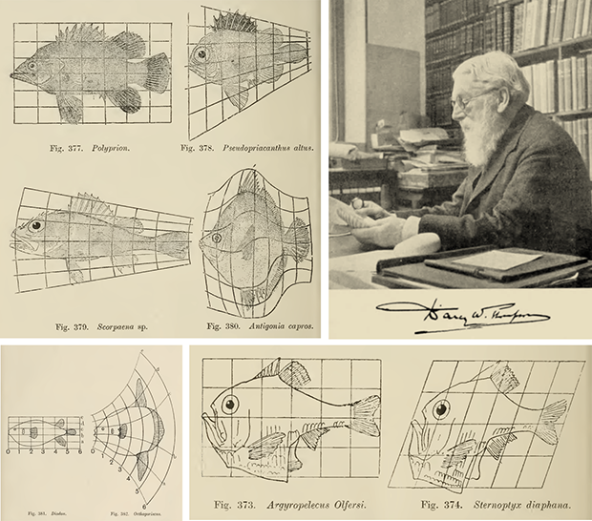
Deformable Registration
Image: Wolfram Blog

Slide 6
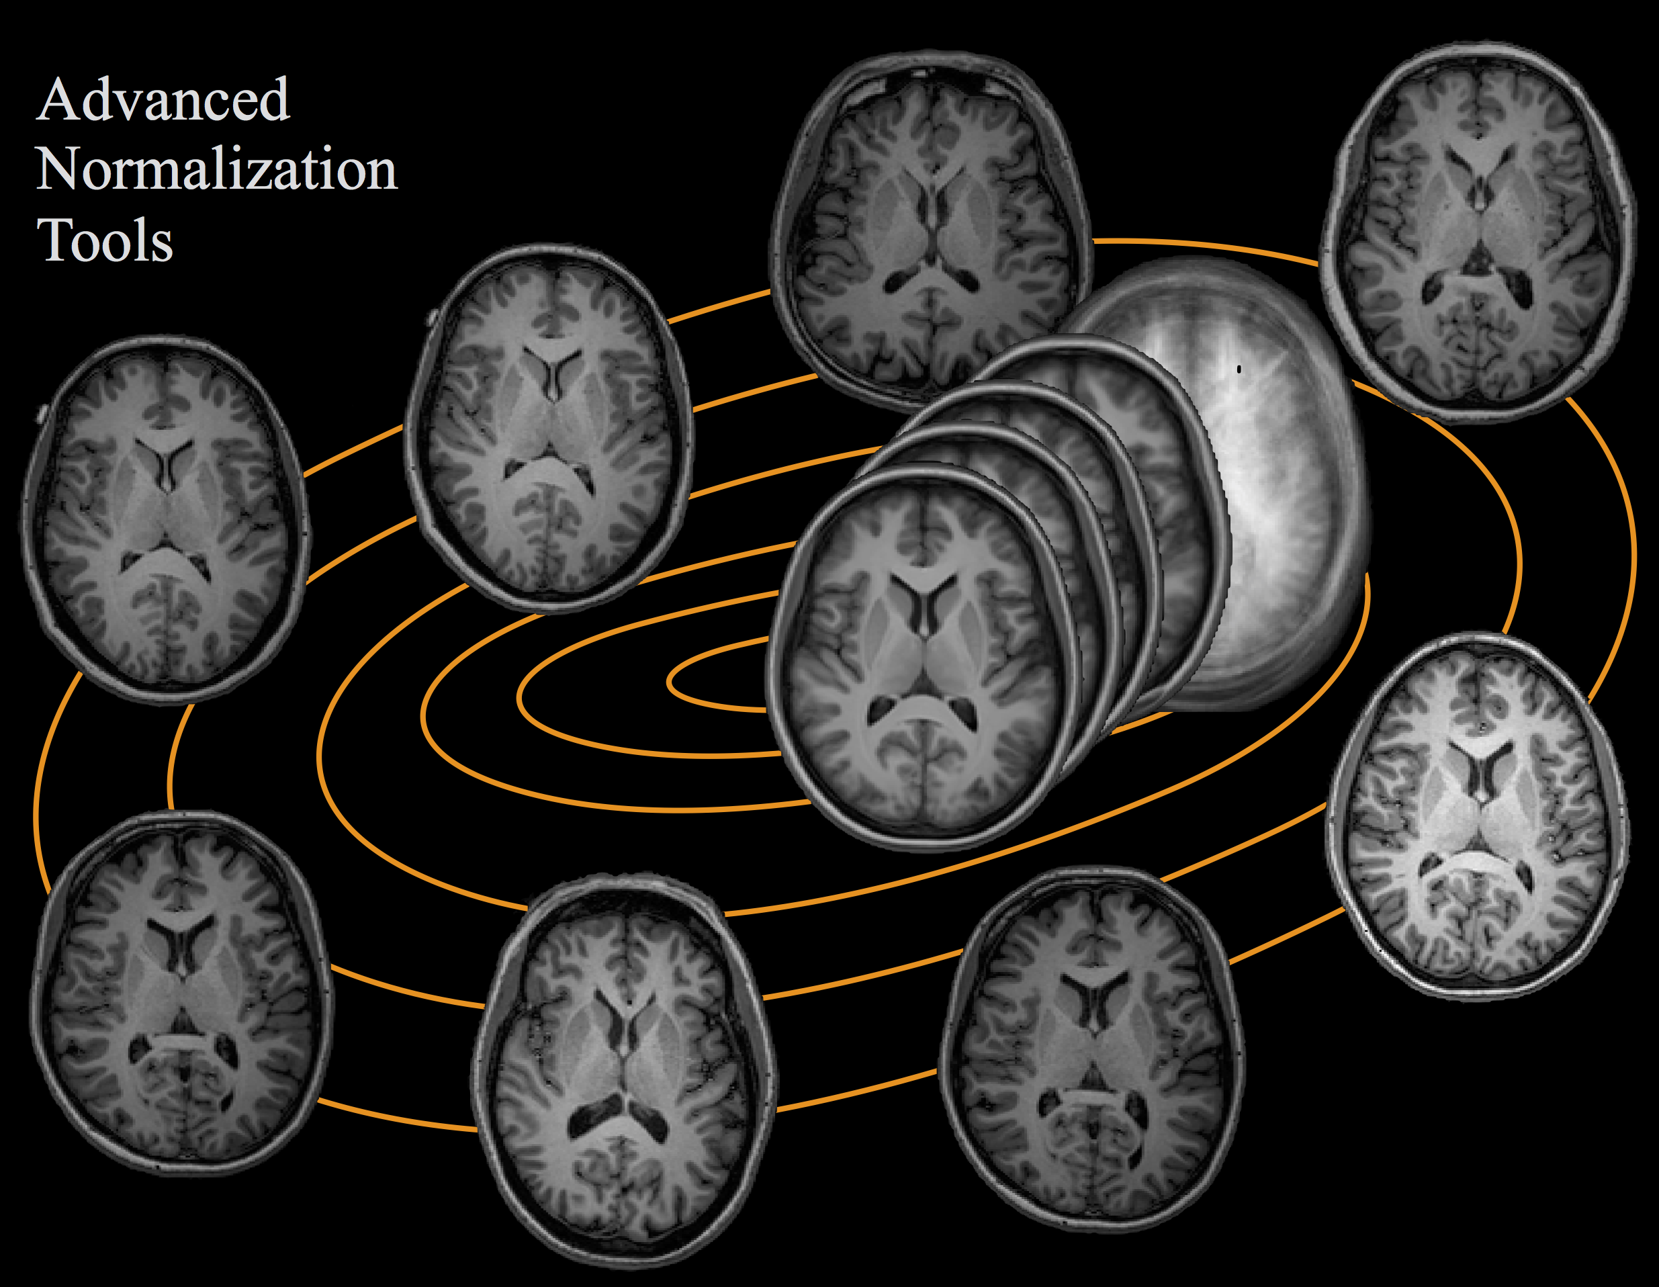
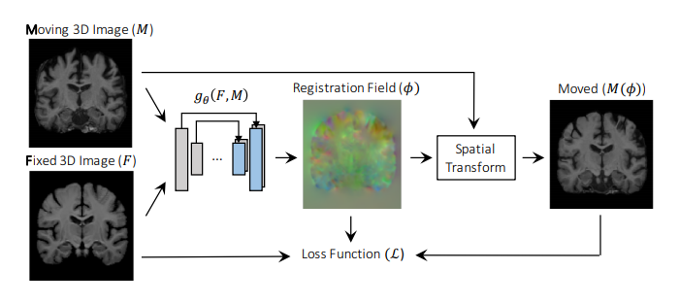
Deformable Registration
Image: ANTsX
Image: VoxelMorph

Slide 7
Non-trivial optimization for each sample.
Accurate and interpretable.
High training costs, may need retraining or finetuning.
Fast test-time performance and just as accurate.
Modeling flexibility.

Slide 8
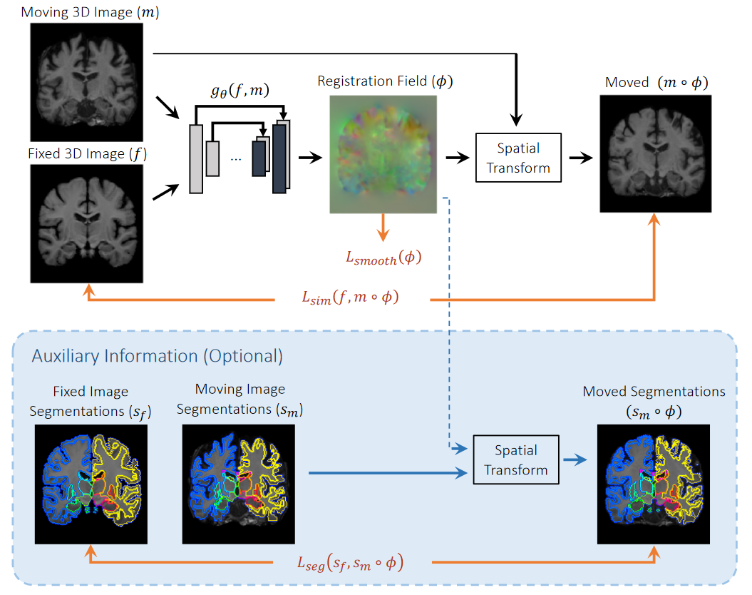
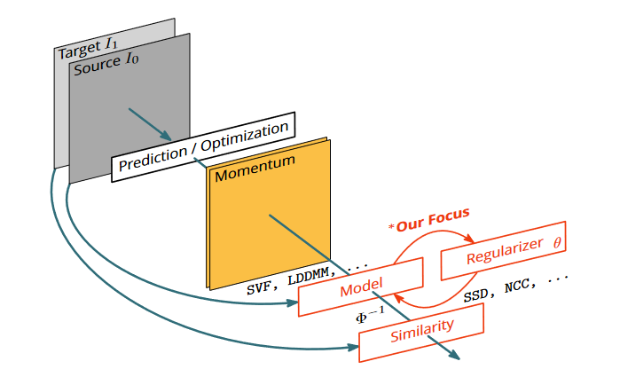
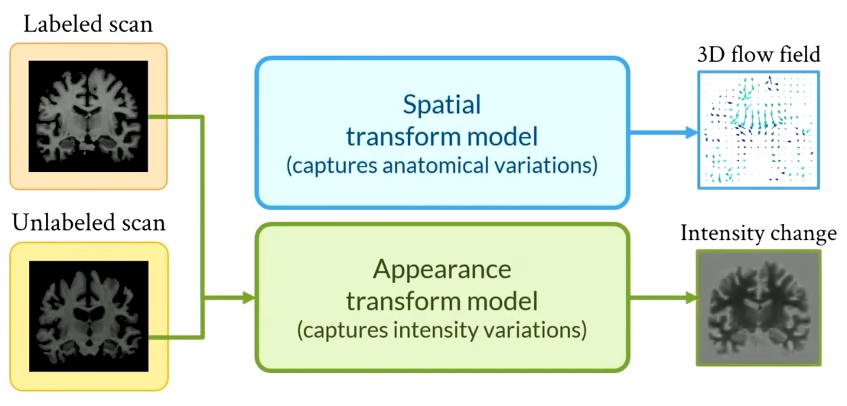
Modeling Flexibility
Zhao, CVPR 2019.
Niethammer, CVPR 2019; Shen, NeurIPS 2020
Balakrishnan, TMI 2019.

Slide 9
Modeling Flexibility
Zhao, CVPR 2019.
Balakrishnan, TMI 2019.

Slide 10
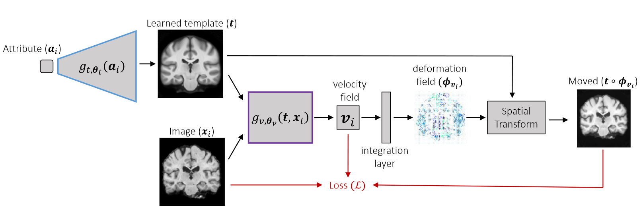
Modeling Flexibility
Deformable Templates
Dalca, et al., NeurIPS 2019

Slide 11
Deformable Templates
Barycentric Representations.
Returns distances between samples and the barycenter.

Slide 12
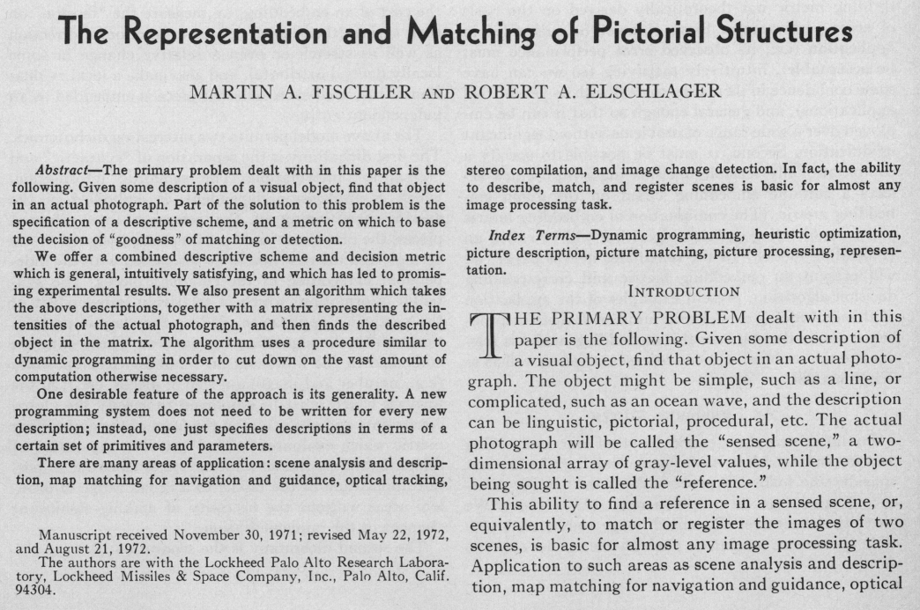
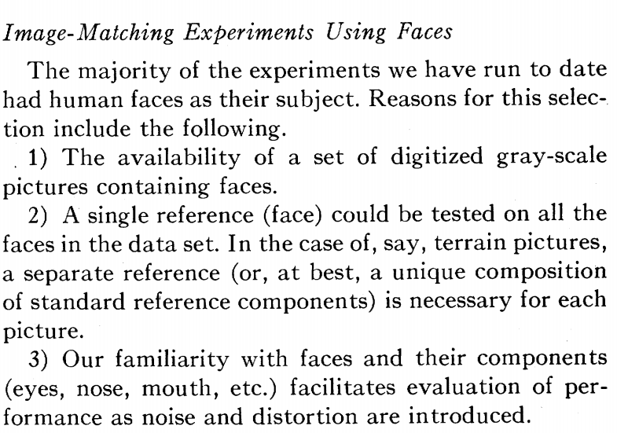
Deformable Templates
Template Matching

Slide 13
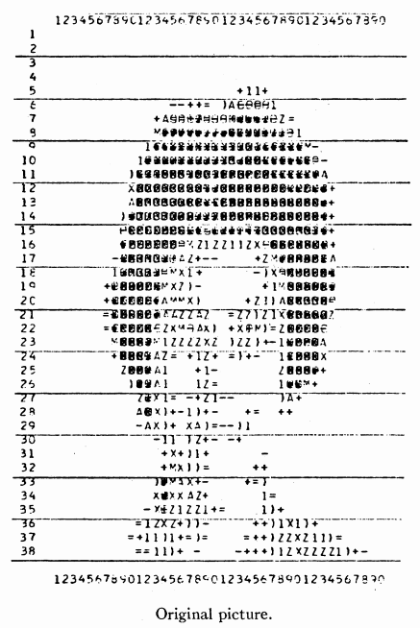
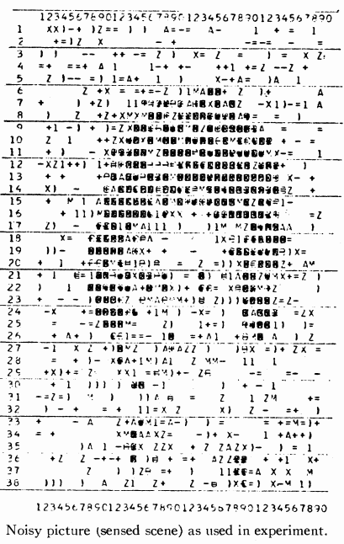
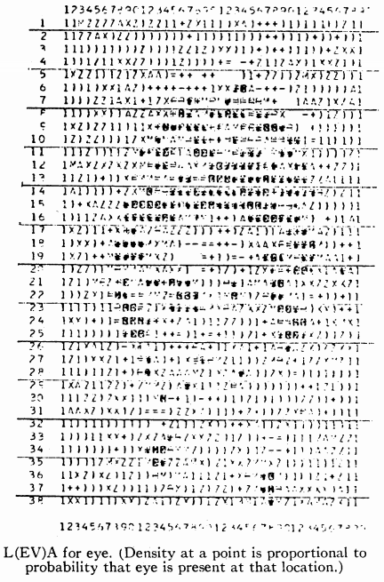
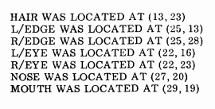
Deformable Templates
Template Matching

Slide 14
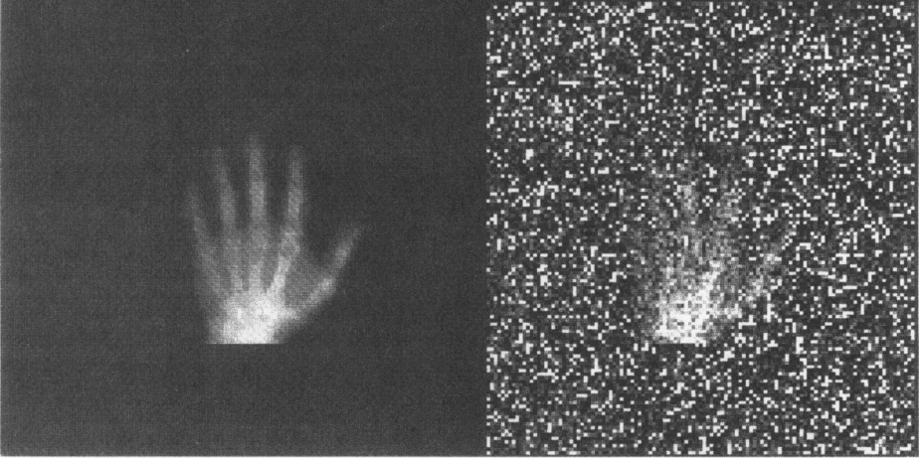
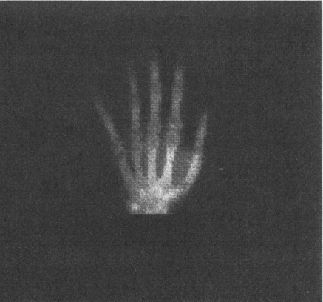
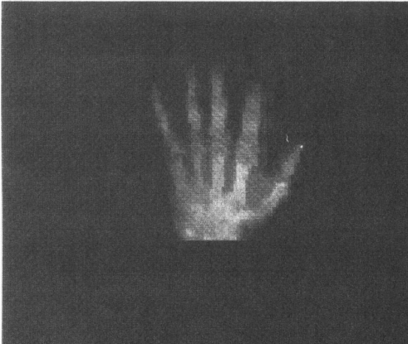
Deformable Templates
Restoration
Clean target
Observation
Template
Deformed Template
Image: Amit, 1991

Slide 15
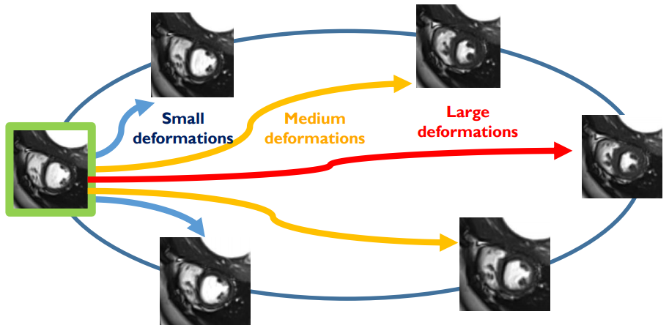
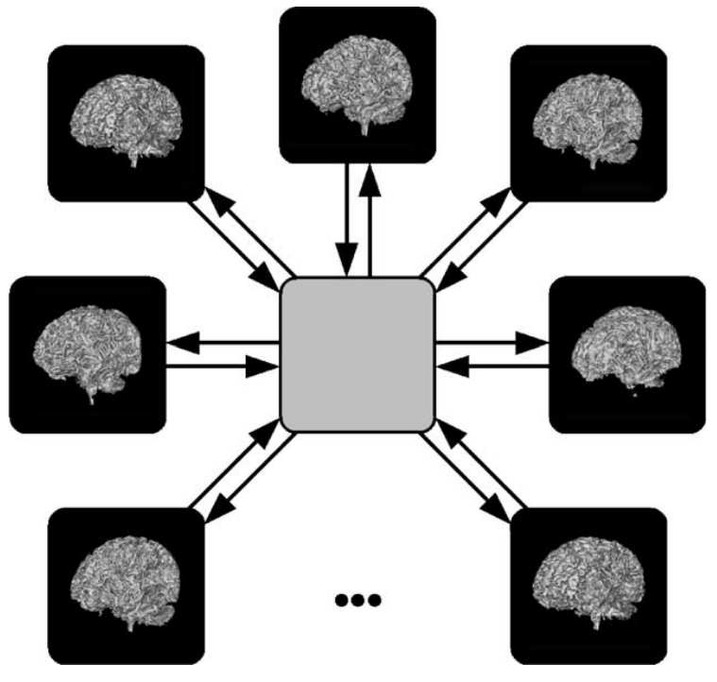
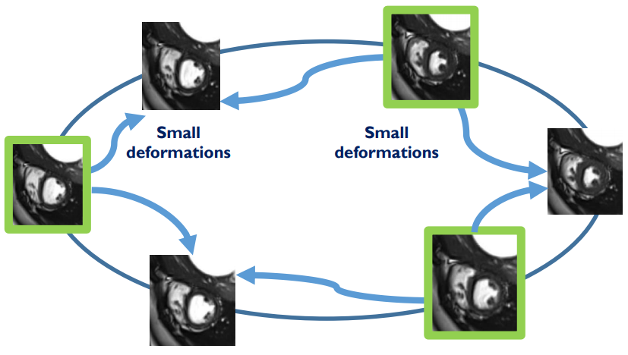
Deformable Templates
Geometric Statistics and Standardized Analyses
Image: Joshi, 2004
Image: Rohé, 2018
Notes:
And segmentation

Slide 16
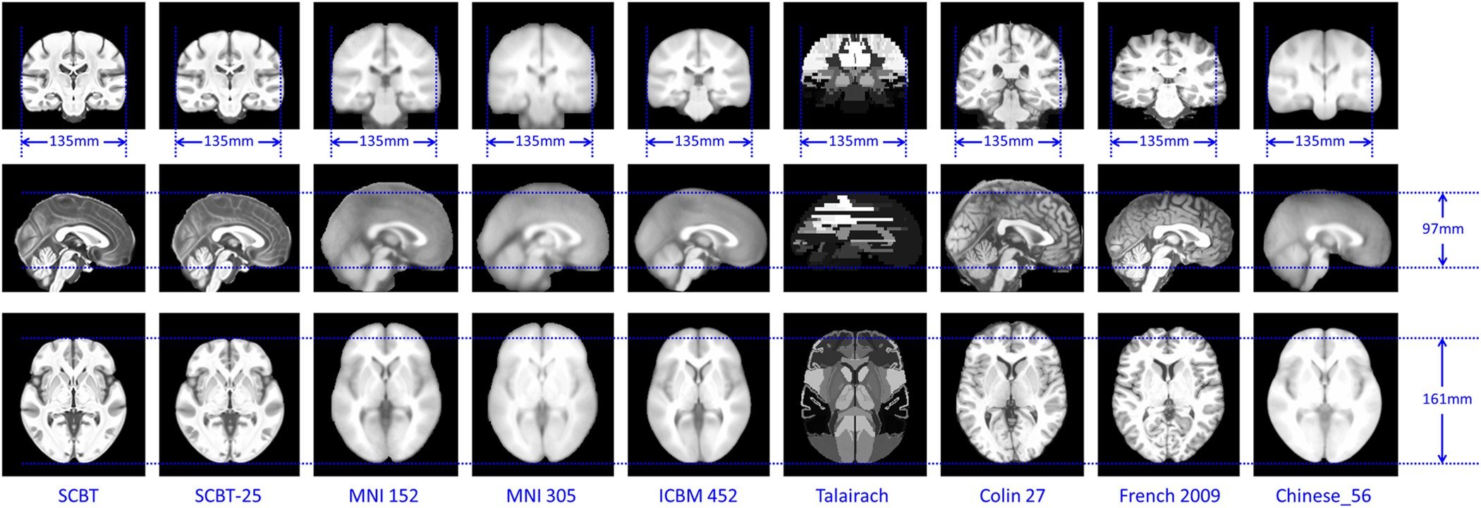
Deformable Templates
Where/how do you find templates?
Reference databases:
Image: Liang, 2016
Notes:
Problems: single-atlas doesn’t capture population variability, if you have publicly available temporal atlases, they may not fit your needs either; template biases studies

Slide 17
Deformable Templates
Where/how do you find templates?
Better: Build them yourself

Slide 18
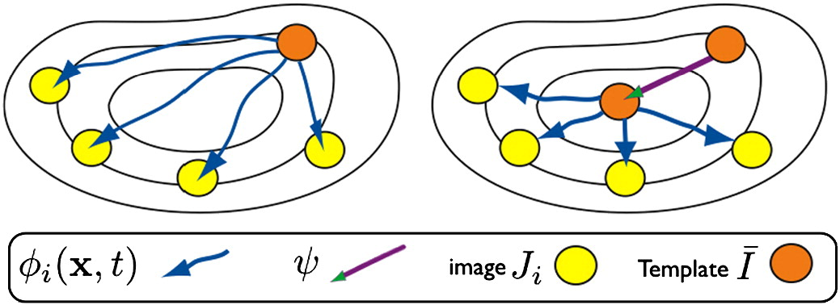
Deformable Template Construction
Implicit
Explicit
Initialize template as linear average.
Register images to template and average.
Update template appearance and shape.
Go back to 2 until convergence.
Template: a voxel-grid of free parameters.
Update parameters alongside registration network with SGD.
Image: Avants, 2008.
Image: Dalca, 2019.

Slide 19
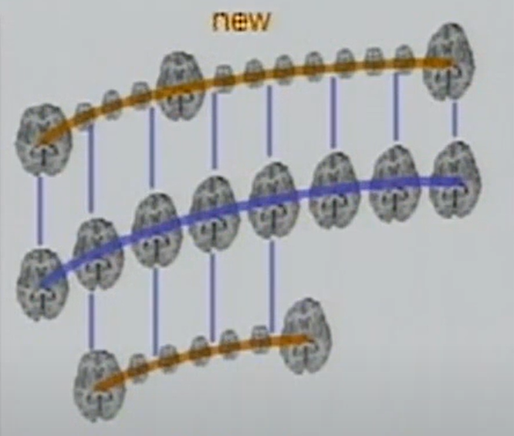
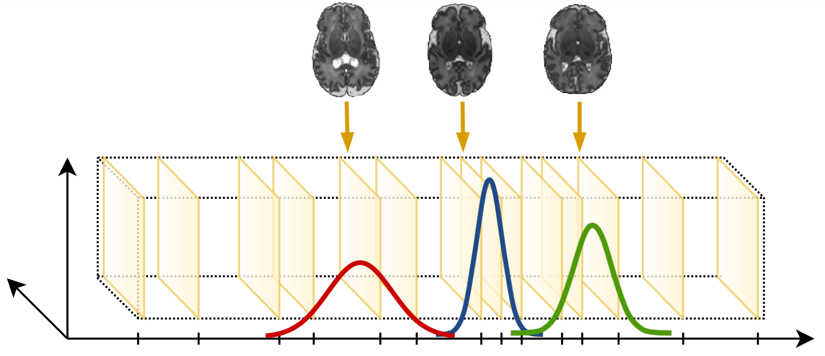
Deformable Template Construction
Conditional Implicit
Image: Niethammer, 2011.
Image: Schuh, 2018.

Slide 20
Deformable Template Construction
Conditional Explicit
Image: Dalca, 2019.

Slide 21
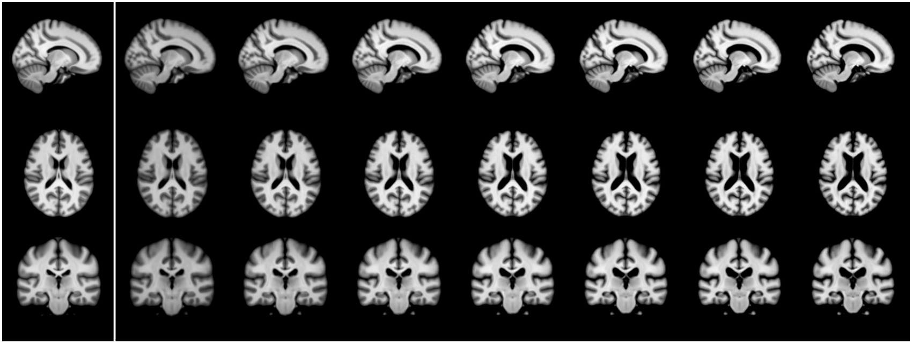
Deformable Template Construction
Conditional Explicit
Image: Dalca, 2019.

Slide 22
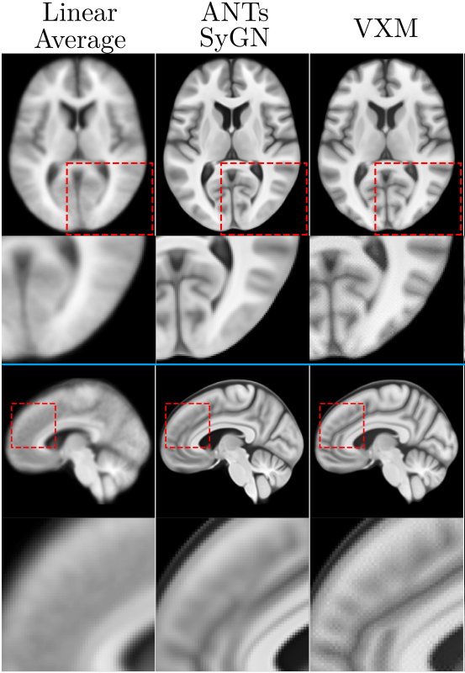
Deformable Template Construction Hurdles
Regularized registration objectives in isolation.
Brain topology highly variable.

Slide 23
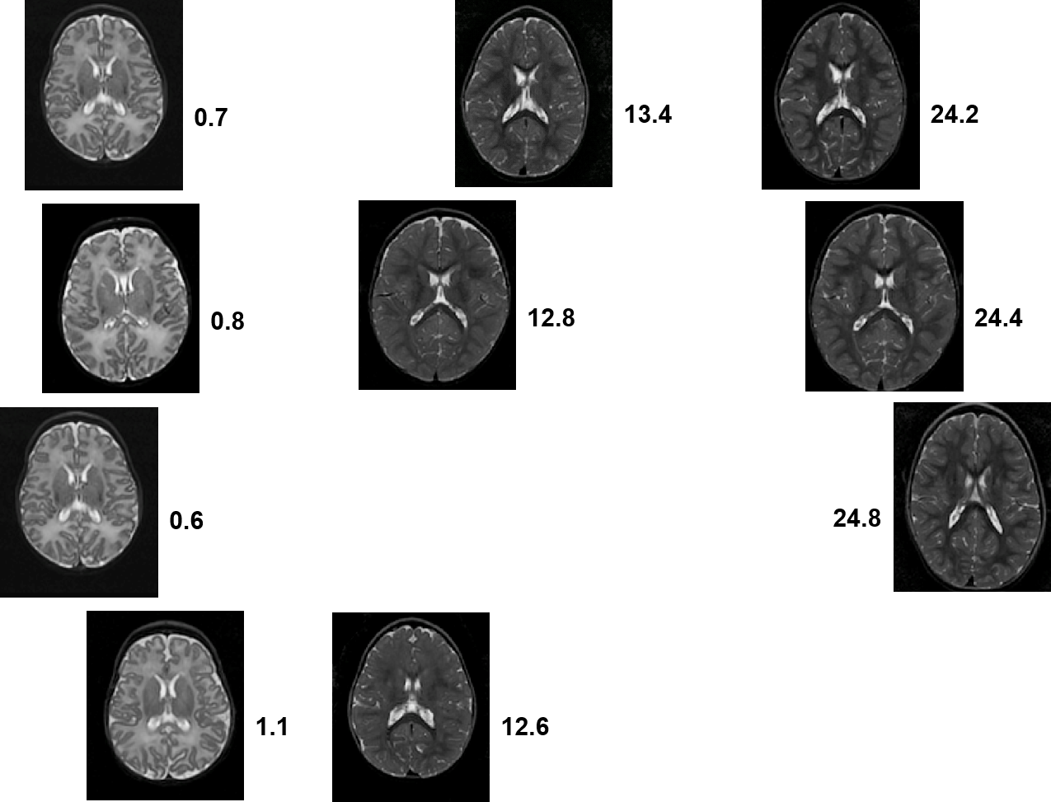
Deformable Template Construction Hurdles
Modeling hard-to-tune.
Irregularly-sampled data.
Appearance changes.
Image: Schuh, 2018.
Image: James Fishbaugh

Slide 24
Deformable Template Desiderata
Realistic Deformations
Local regularization
Sharp Atlases
Intensity-control
Condition-specificity
Data-agnostic
Visual Synthesis

Slide 25
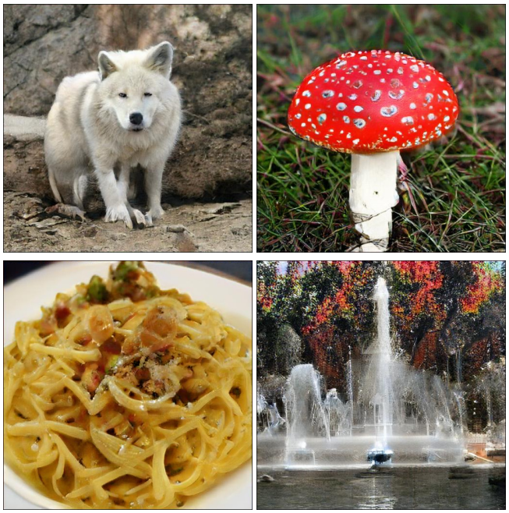

GANs
Realism and Sharpness
Brock, 2019.
Karras, 2019.

Slide 26
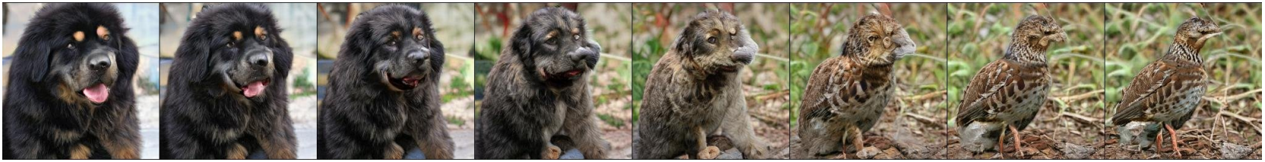
GANs
Condition Specificity
Brock, 2019.

Slide 27
Deformable Template GANs?
Real/Synthesized?
D
Not quite.

Slide 28
Deformable Template GANs?
Real/Synthesized?
D
Not quite.

Slide 29
Deformable Template GANs?
GANs stable w/:
Low image resolution.
High sample sizes.
High batch sizes.
High compute, strong overparameterization.
What we have:
None of that.

Slide 30
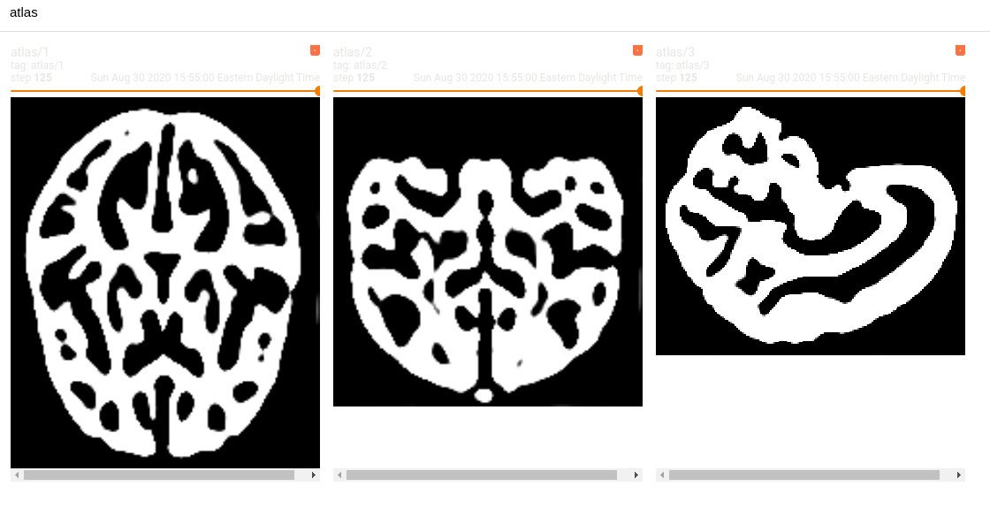
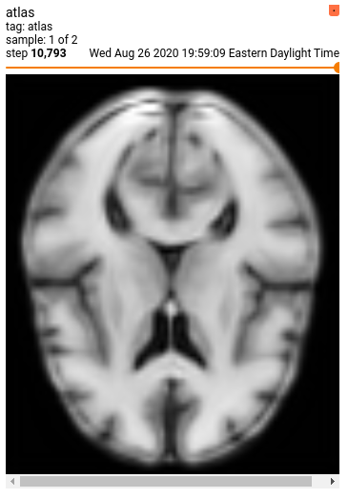
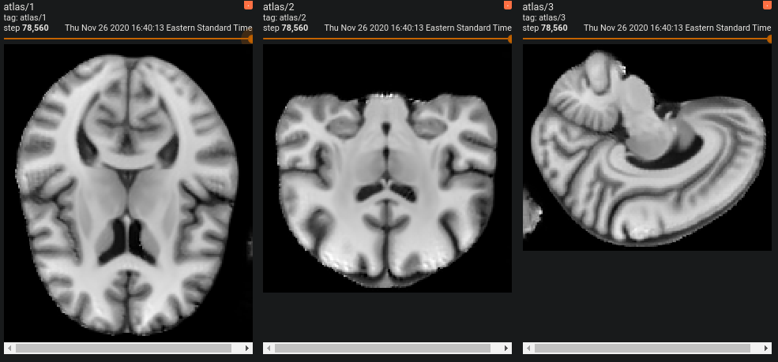
Naïve Attempts

Slide 31
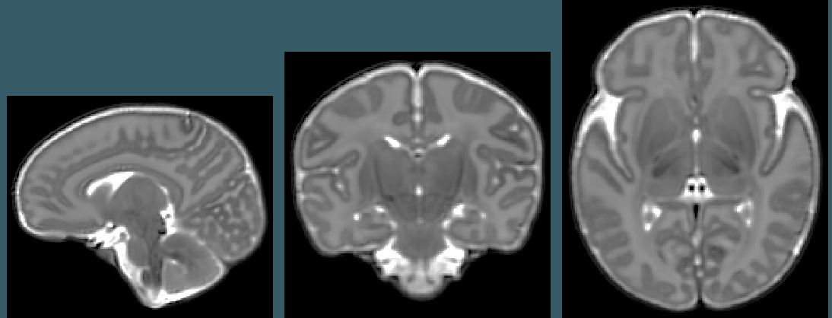
(less) Naïve Attempts

Slide 32
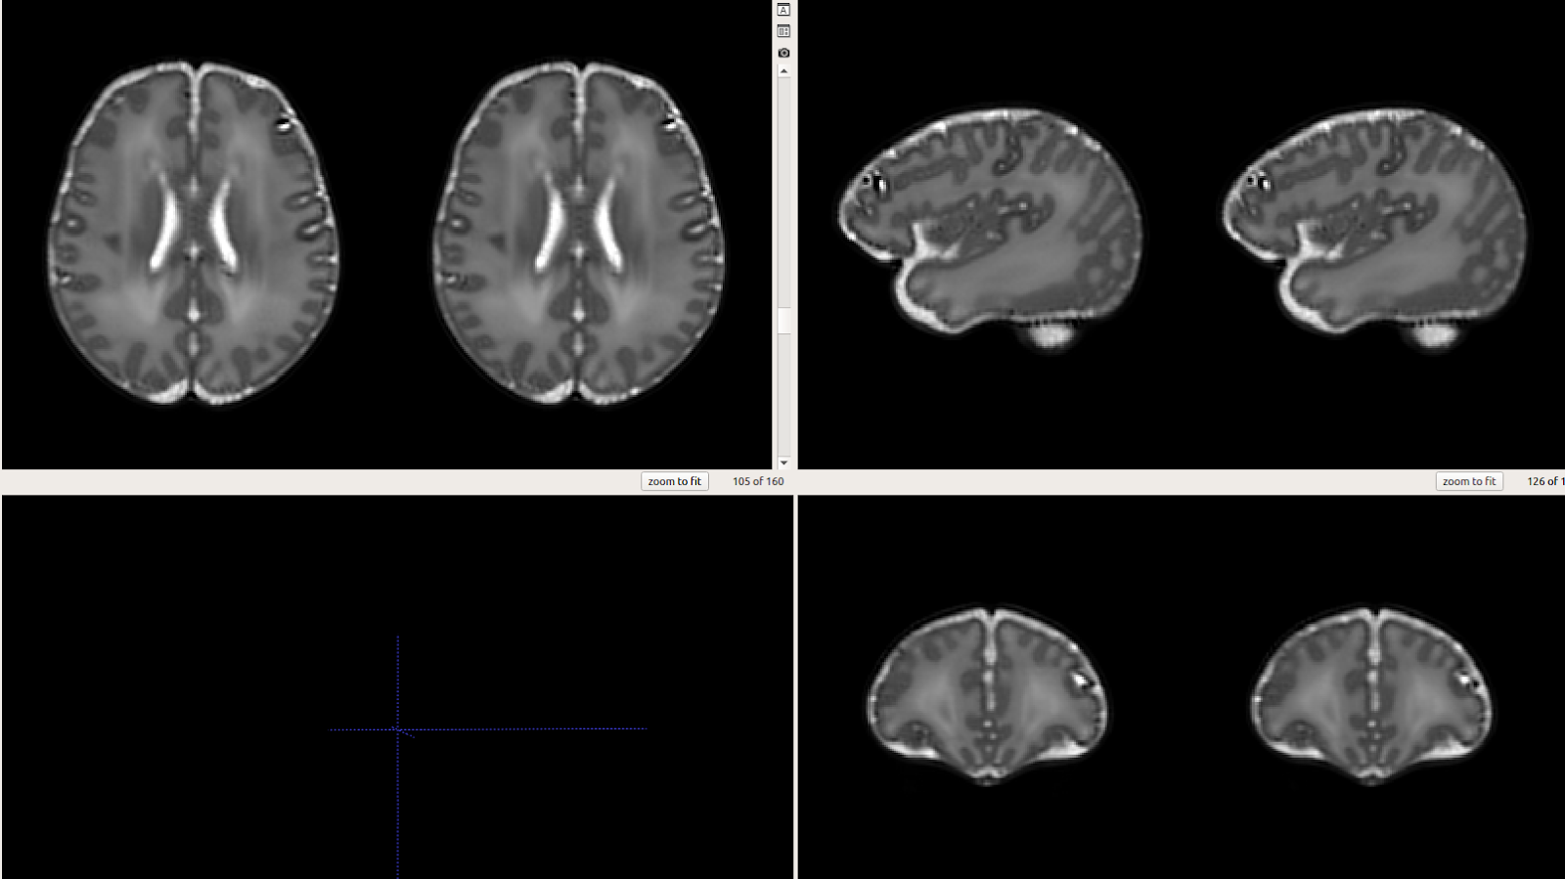
(less) Naïve Attempts

Slide 33
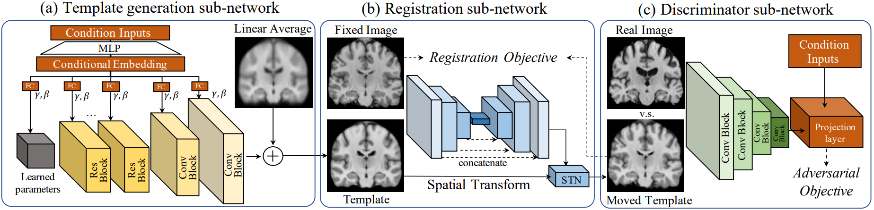
Framework Overview

Slide 34
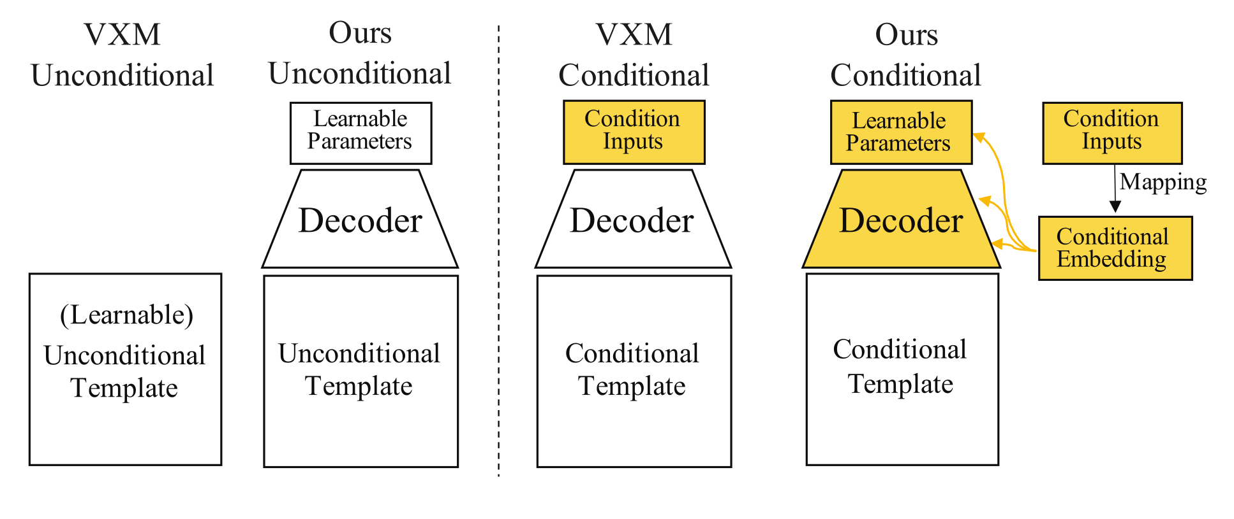
Template Generator Network
Strategy:
Project condition to large vector
Reshape to half-res features
Convolutional upsampling
Add to linear average.
Room for improvement:
Projection may not scale
Conditioning
Use powerful, param-efficient conditioning
No visual prior
Checkerboarding

Slide 35
Template Generator Network

Slide 36
Template Generator Network
z : Input condition
h : Feature map
c : Channel index
i : Layer index

Slide 37
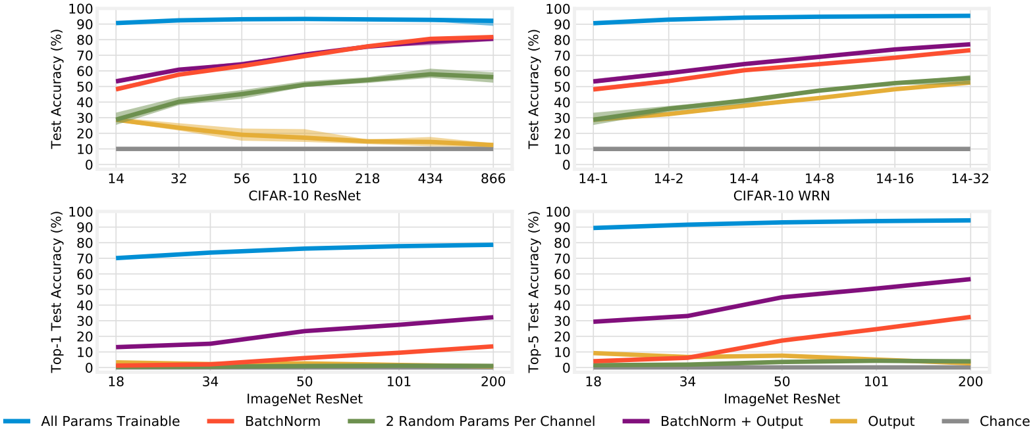
Template Generator Network
Frankle, 2021.

Slide 38
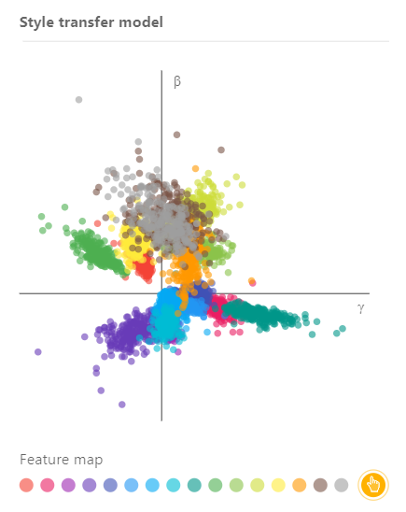
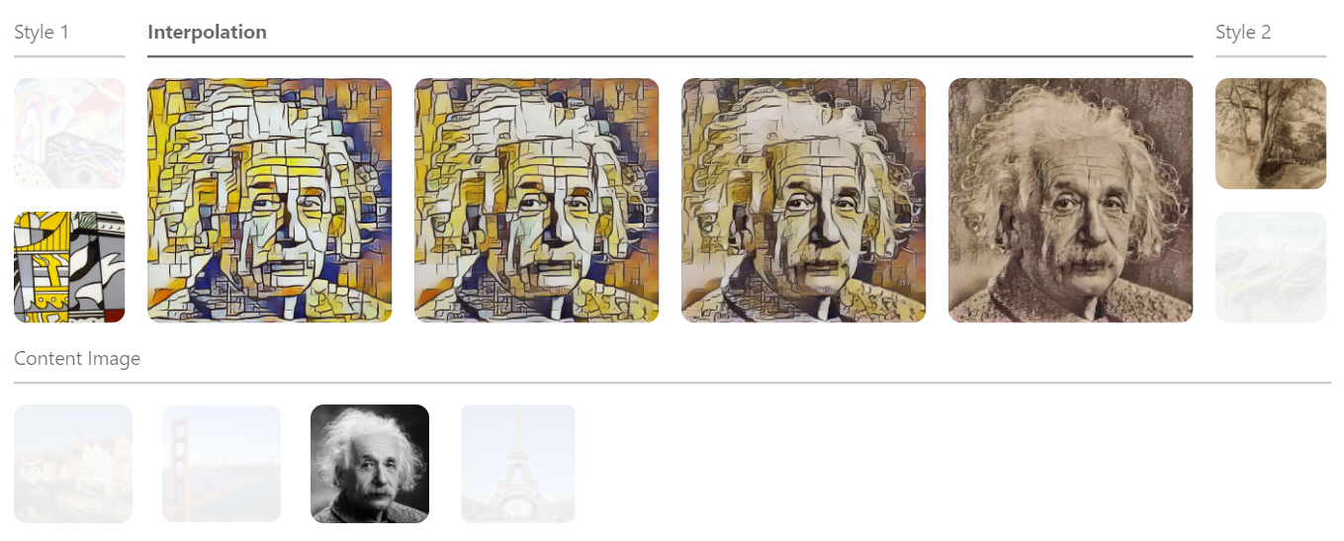
Template Generator Network
Dumoulin, 2018.

Slide 39
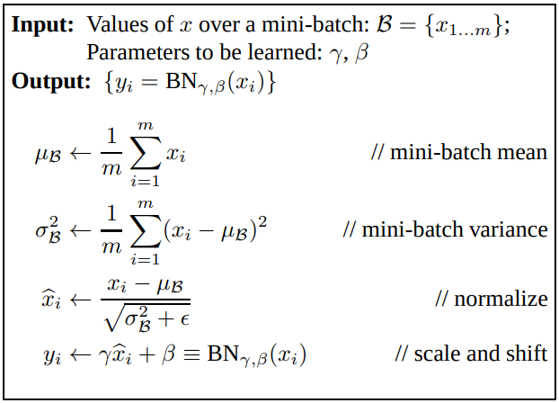
Template Generator Network
Szegedy, 2016.

Slide 40
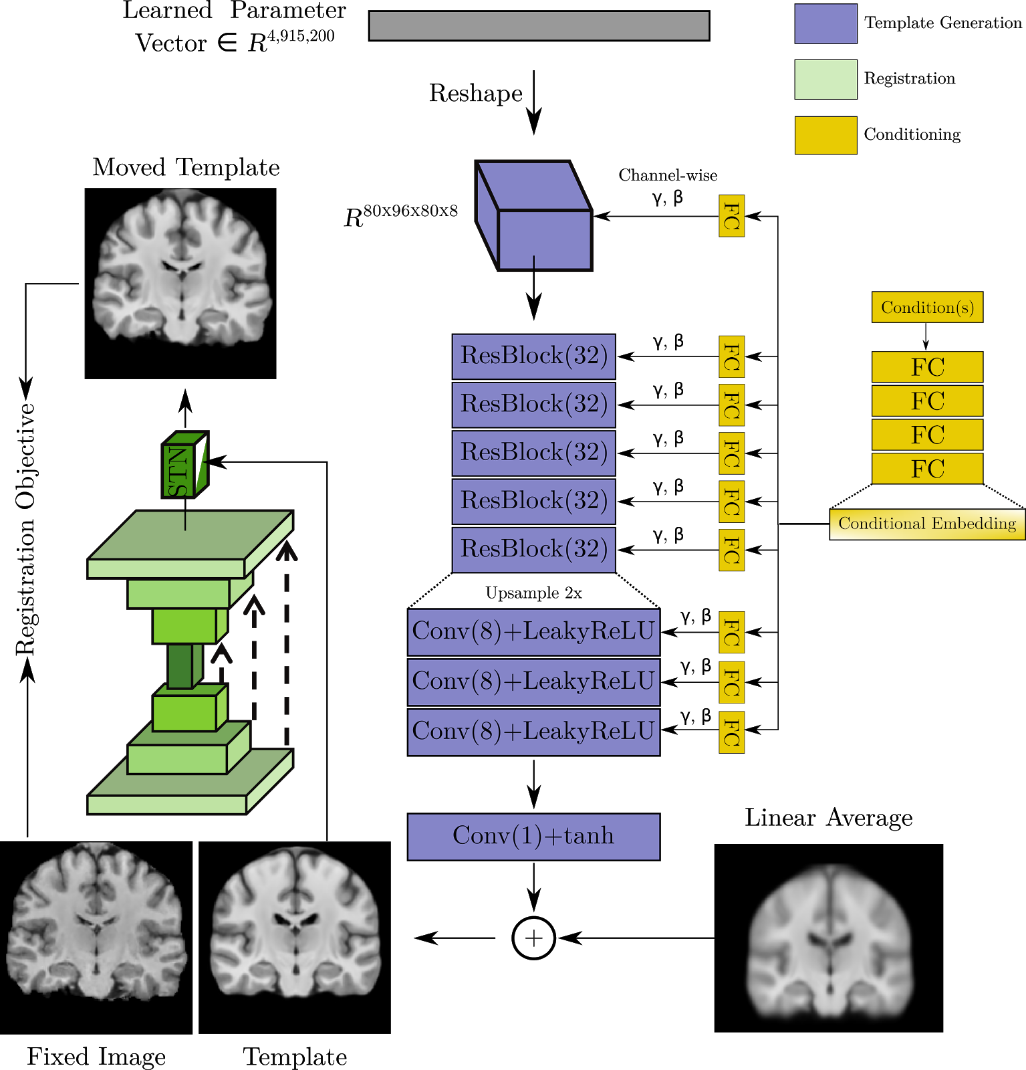
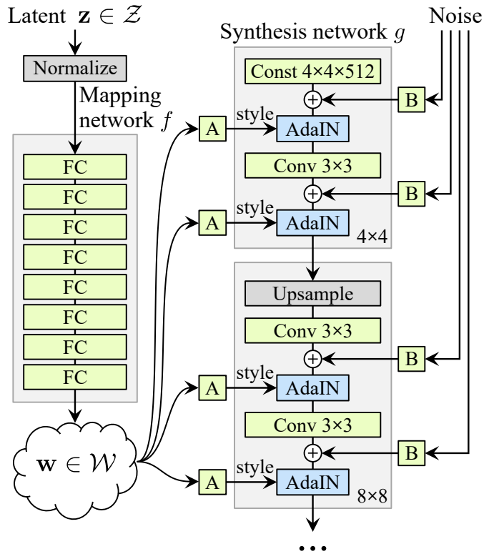
Template Generator + Registration Network
Karras, 2019.

Slide 41
Template Generator + Registration Network

Slide 42
Discriminator Network
Discriminator Overfitting
Mitigation Strategies:
Local vs. global feedback
1-Lipschitz
Gradient penalties
Data augmentation
Need conditionality

Slide 43
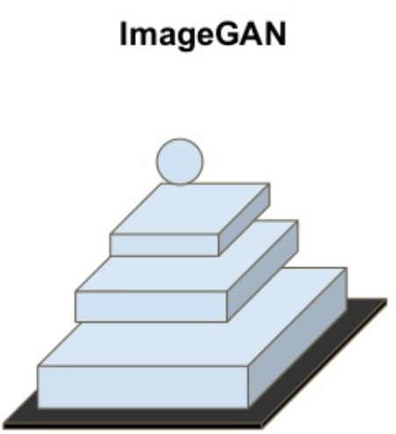
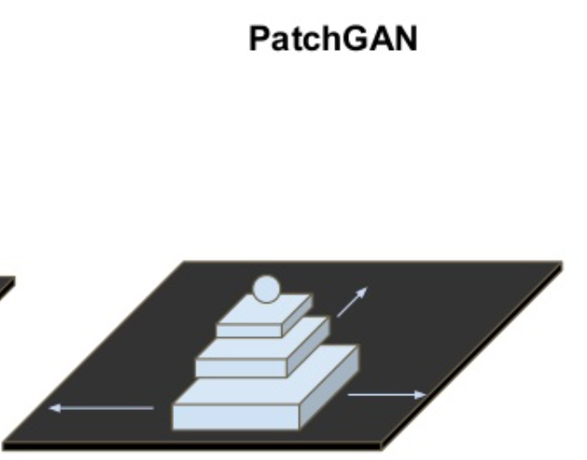
Discriminator Network
Local vs. global feedback
Fully-convolutional Discriminator
63x63x63 receptive field
Image: Victor Garcia
Notes:
Only maintains coherence because of global consistency loss

Slide 44
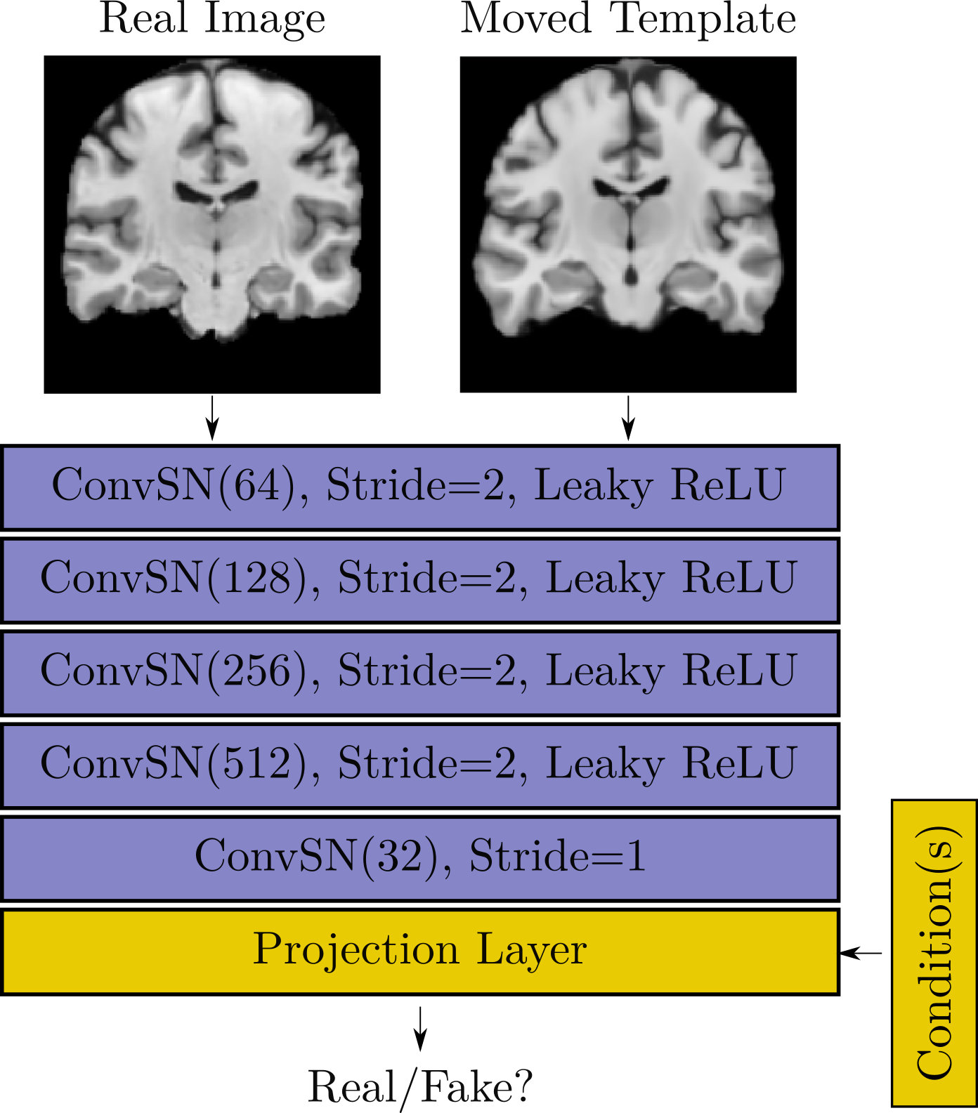
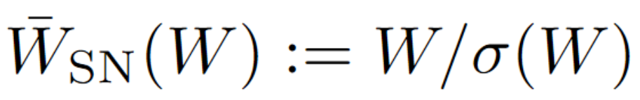
Discriminator Network
Spectral Normalization [Miyato, 2018]
Gradient penalty [Mescheder, 2018]

Slide 45
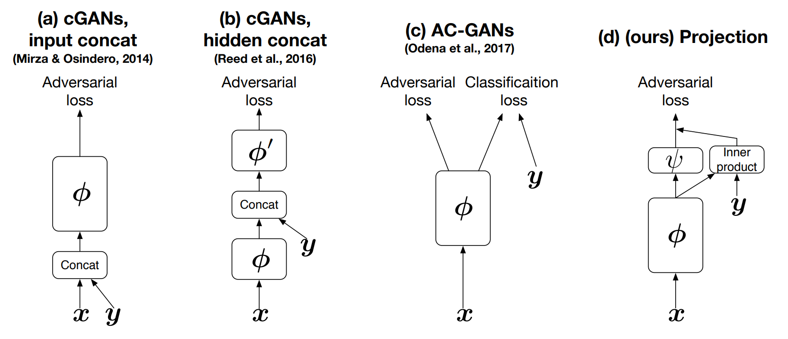
Discriminator Conditioning
Miyato, 2018.

Slide 46


Discriminator Conditioning
Categorical or continuous.
For both,

Slide 47
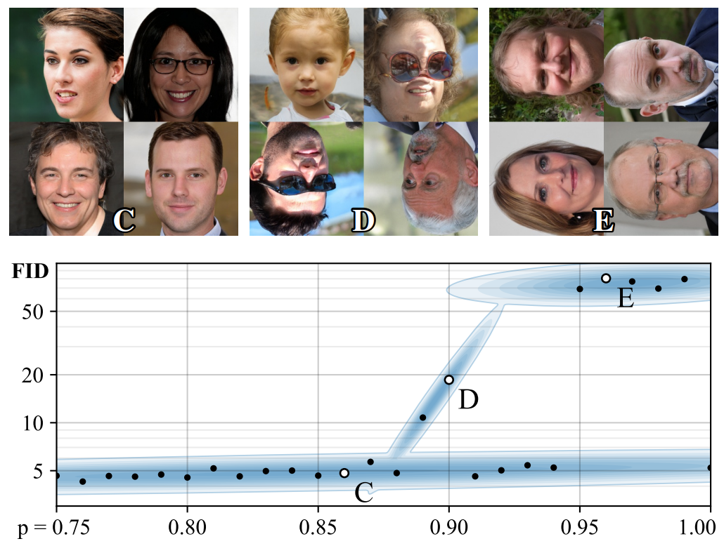
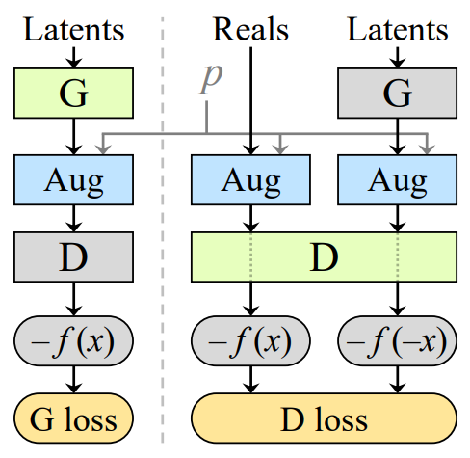
GANs for small data
Zhao, 2020
Karras, 2020
Zhao, 2020
Tran, 2020
Dey, 2020
Karras, 2020.

Slide 48
Generator Objective
Registration
Moving Average
Deformations
Smooth
Deformations
Small
Deformations
GAN Term
VoxelMorph Templates

Slide 49
Discriminator Objective
GAN Term
Gradient
Penalty

Slide 50


Experiments
Predict-HD
22.5 yrs
42.5 yrs
62.5 yrs
82.5 yrs
Controls
Huntington’s

Slide 51

Experiments
Predict-HD
Controls and HD-risk
Subject-wise split 898 train, 30 val, 190 test
Age and Genetic-risk conditioned Templates

Slide 52

Experiments
Predict-HD

Slide 53


Experiments
Developing Human Connectome Project (dHCP)

Slide 54


Experiments
Developing Human Connectome Project (dHCP)

Slide 55

Experiments
FFHQ-Aging
60k images; condition on (age, gender, sunglasses)

Slide 56
Experiments
Baselines:
ANTs SyGN [Avants, 2008]
VoxelMorph [Dalca, 2019]
Ablations:
VoxelMorph + GAN
New Architecture / no GAN

Slide 57
Experiments
Evaluation Criteria:
Volume Overlap
Sharpness
Volume trends
Deformation Quality:
Centrality
Magnitudes
Smoothness

Slide 58


Results

Slide 59

Results

Slide 60
Results

Slide 61

Results

Slide 62
Results

Slide 63

Results

Slide 64

Results

Slide 65

Results

Slide 66

Results

Slide 67



Results
VXM
Proposed

Slide 68

Results

Slide 69

Results

Slide 70






Results

Slide 71

Results

Slide 72

Results

Slide 73

Results

Slide 74

Results

Slide 75

Results

Slide 76

Weaknesses
Computation
Simpson’s paradox
Image: Wikipedia

Slide 77

Questions
Hard to distinguish groups?
Appearance changes?
ACE-IBIS

Slide 78

Questions
Hard to distinguish groups?
Appearance changes?
ACE-IBIS

Slide 79
Summary
Generative synthesis approach to Templates
Enable training on difficult datasets
Templates sharp, representative, easy-to-interpret
Works across diverse datasets
www.neeldey.com/deformable-templates

